Slide 1
Syntax of Razor Pages

Slide 2
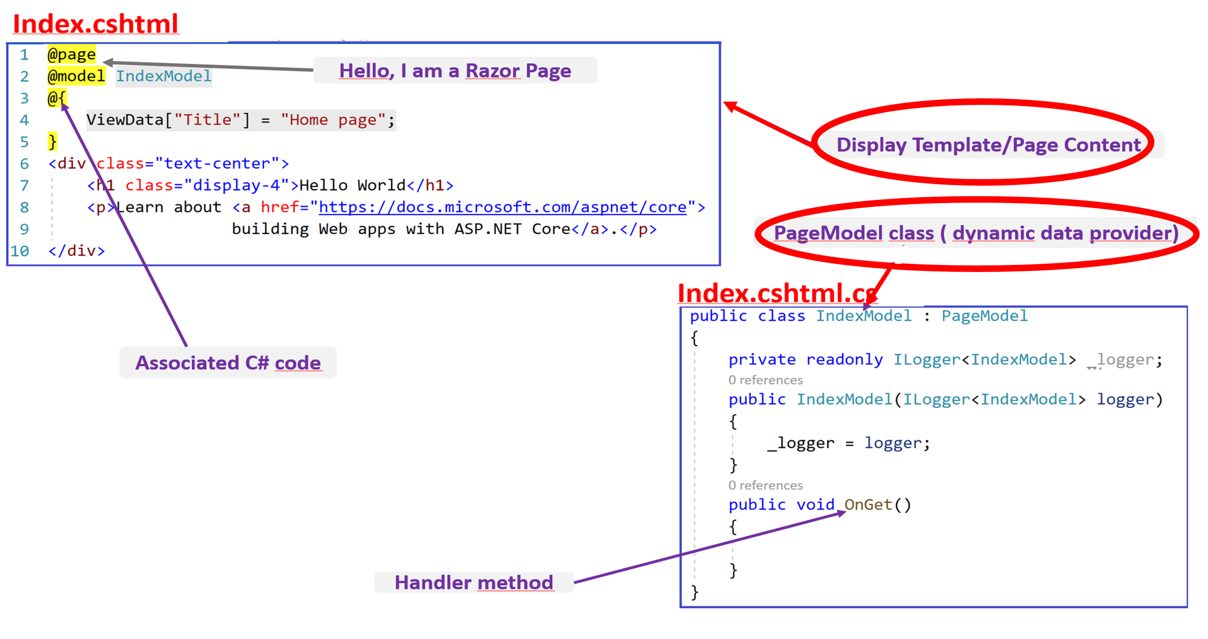

Slide 3
Display template/ Page Content

Slide 4
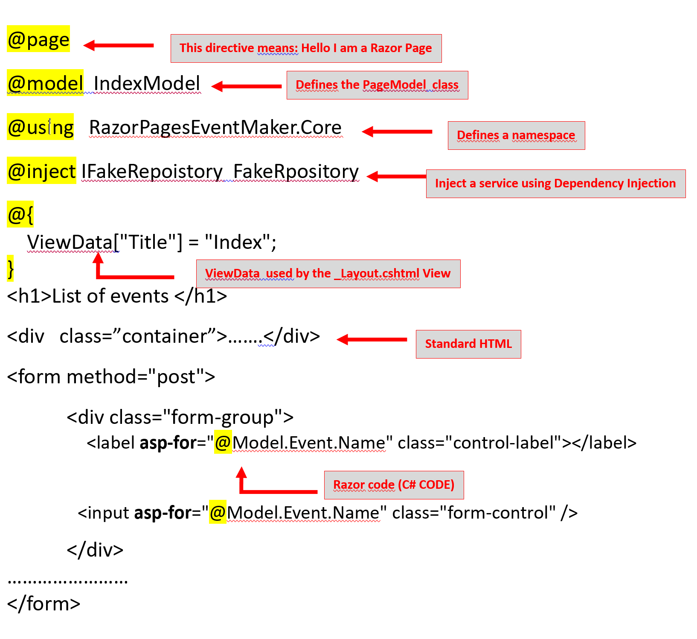
Anatomy of a page content
Notes:
@page - Identify the file as a Razor Page. Without it, the page is simply unreacheable by ASP.NET Core. @model - much like in an MVC application, defines the class from which originates the binding data, as well as the Get/Post methods requested by the page. @using - the regular directive for defining namespaces. @inject - configures which interface(s) instance(s) should be injected into the page model class. @{ } - a piece of C# code inside Razor brackets, which in this case is used to define the page title. <div…> - the regular HTML code that comes along with the Razor-enabled C# Code.

Slide 5
Razor Page Syntax
Razor code blocks are enclosed in @{ // insert C# code here….}
Code statements end with semicolon ;
Inline Expressions( variables and fucntions) starts with @
<span>@item.Name</span>
Strings are enclosed with quotation marks ” ” .
C# code is case sensitive.

Slide 6
Code Block | @ { int x=123; string y=”Hello World” ; }
Combining Text and markup | @foreach (var item in items) { <span>@item.Name</span> <span>@item.Age</span> }
Mixing code and lain text | @if (Success) { <p>Congratulations </p> } else { <p>Try again </p> }

Slide 7
Explicit Expressions | <span> ISBN @(isbnNumber)</span>
Escaping the @sign | <span> In Razor Pages , you use the @@foo to display the value of foo </span>
Boolean attributes | <input type=”checkbox” checked=”@isChecked” />

Slide 8
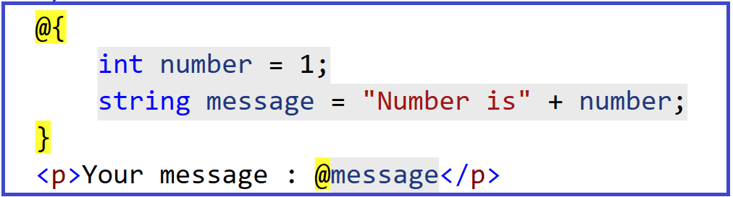
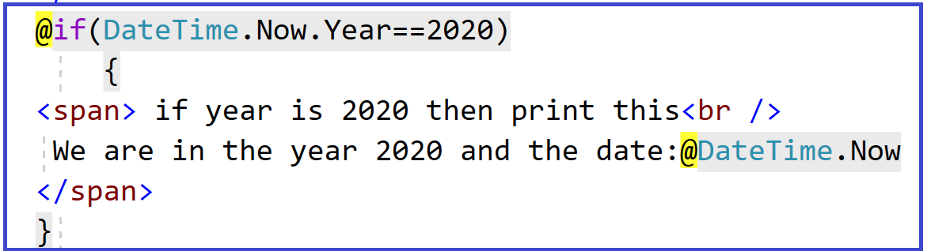
Examples

Slide 9
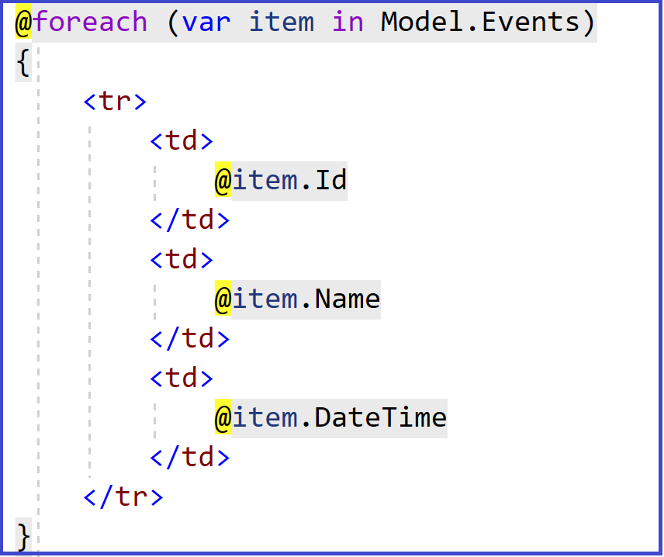
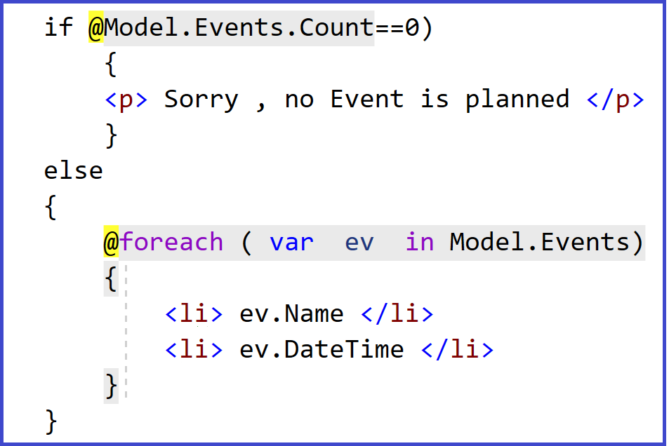
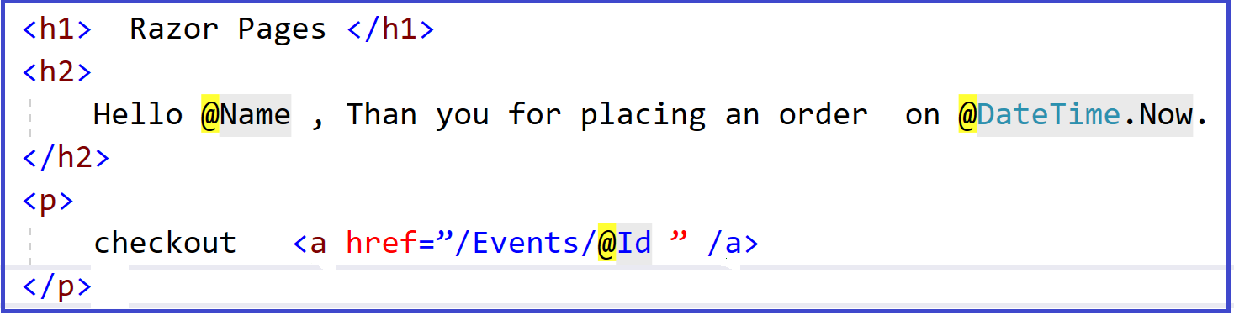
Examples

Slide 10
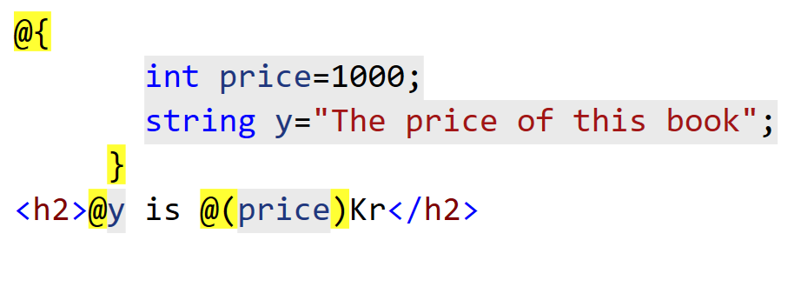
Demo
Consider your first Hello World app.
Copy and place some code ( from these slides) on the Index.cshtml page
Run the application and see the effect.
Example :

